Slide 1
ITems
An Employee Management System...
By: Ileana Luts, Tyler Smalley

Slide 2
High Level View
What does an EMS do?
It assists HR personnel to keep track of employee information
It should provide time management option for employees (ex. Time off request, Time sheets)
It should have an employee portal
It should allow documents to be saved
It can have potentially large number of extra features such as Recruitment (ATS) , Performance tracking, etc.

Slide 3

Solution Overview

Slide 4
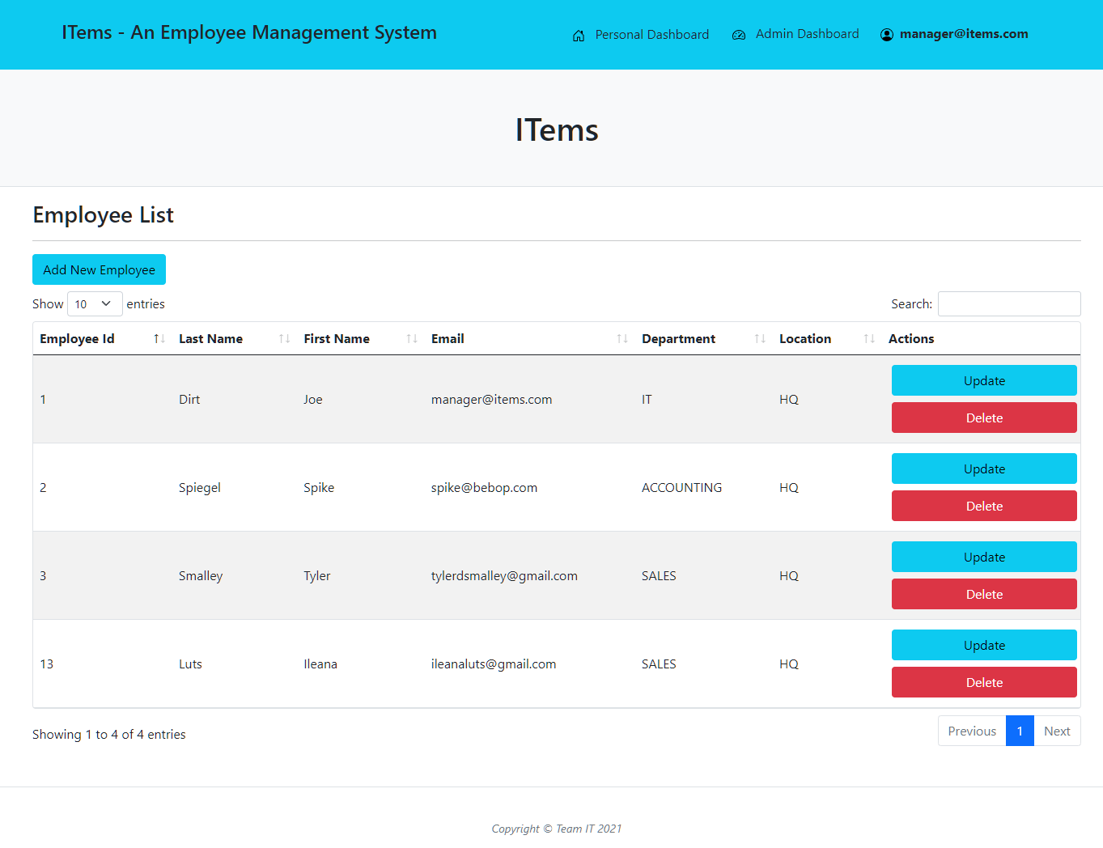
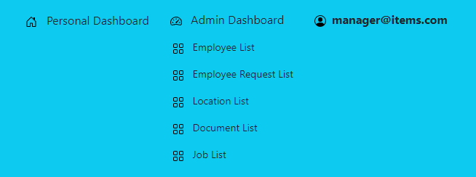
Manager Dashboard - Employee
A manager has an extra menu option - Admin Dashboard
A manager can view a searchable, sortable list of employees
A manager can add new employees, update existing ones, and delete them

Slide 5
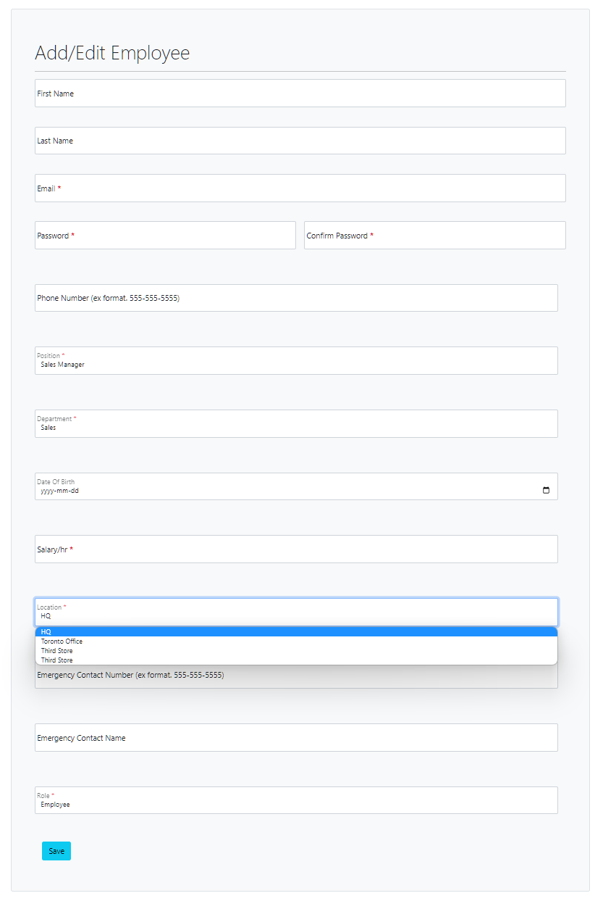
Manager Dashboard - Employee Add
Here’s an example of the add/update employee form
Users with MANAGER role have access to extra form fields

Slide 6
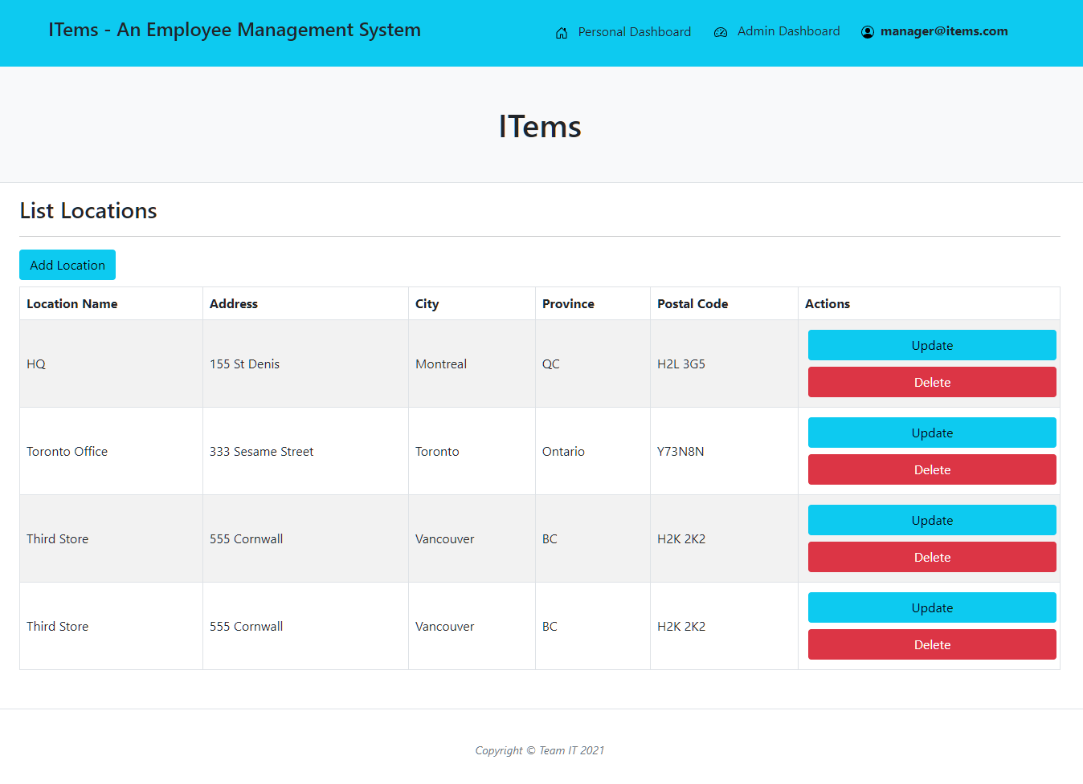
Manager Dashboard - Locations
A manager can view a list of company locations
A manger can Add/Update and delete locations

Slide 7
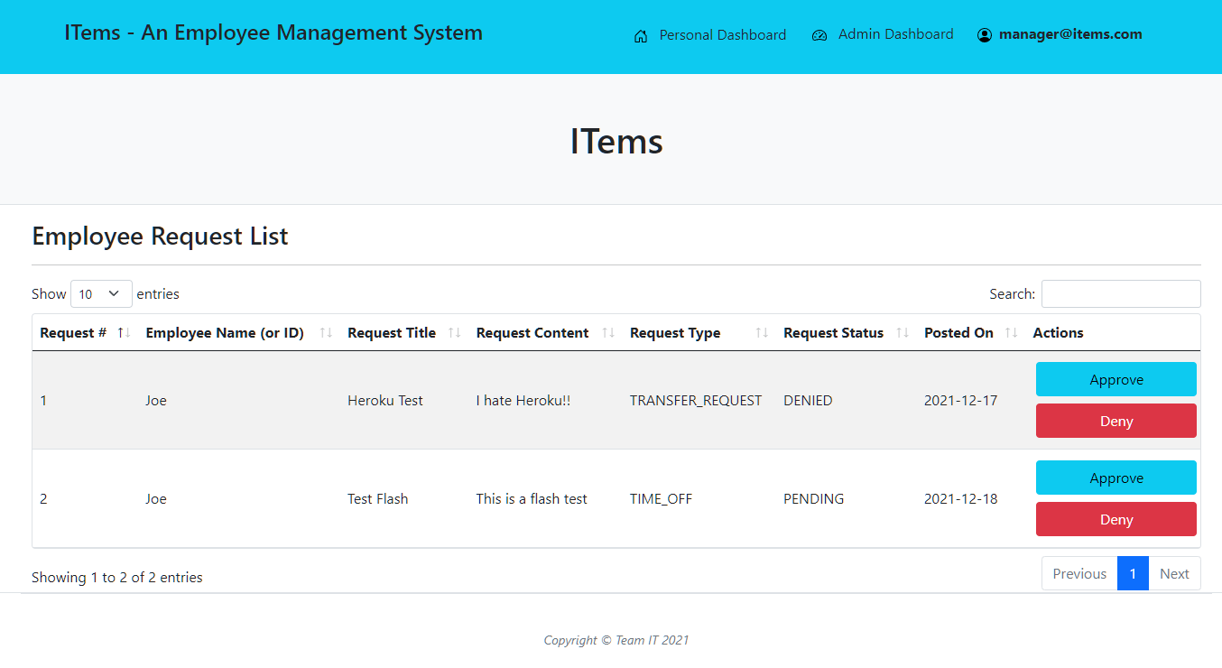
Manager Dashboard - HR Requests
A manager can view a list of requests sent by employees
A manager can Approve or deny requests
Request status will be visible on the employee’s dashboard

Slide 8
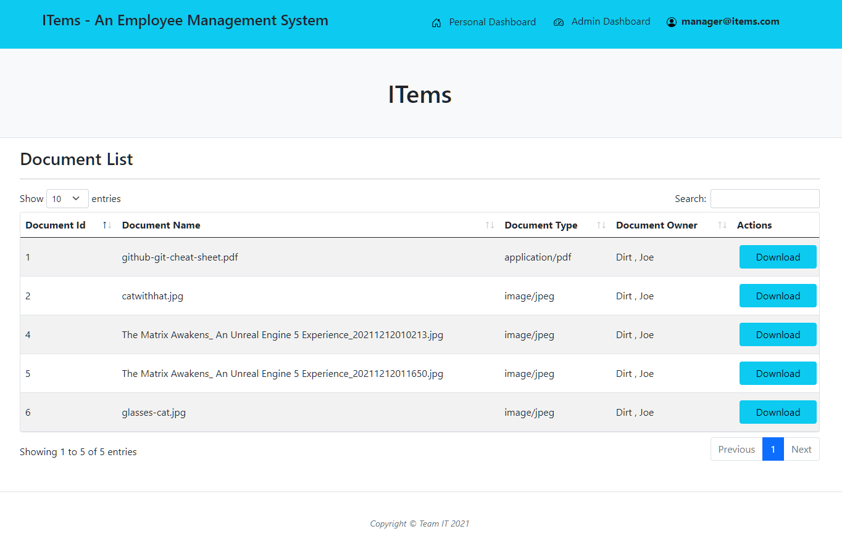
Manager Dashboard - Documents
Manager can view and download the documents of employees

Slide 9
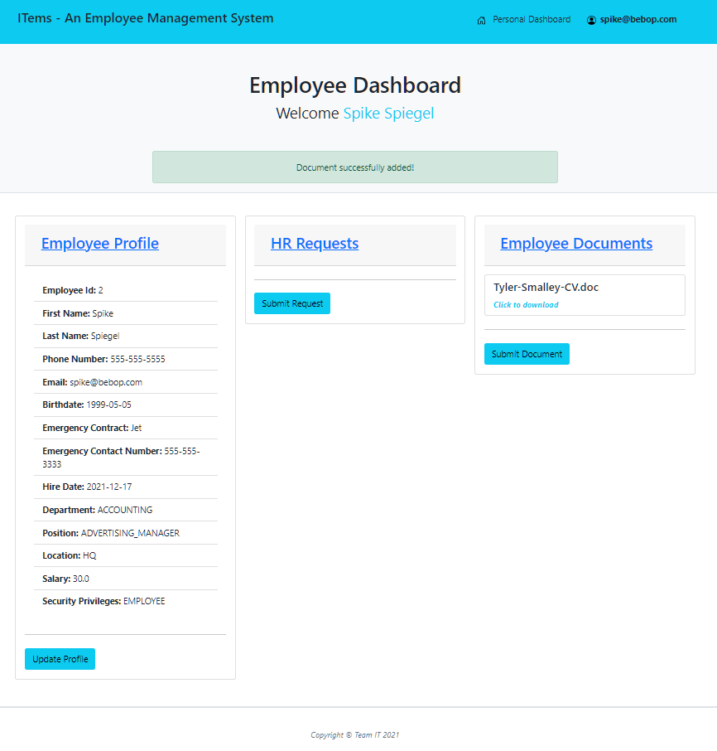
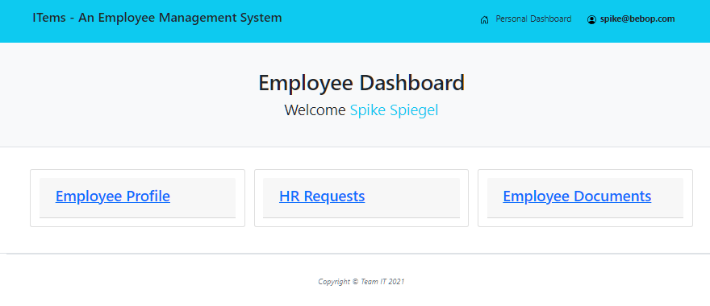
Employee Dashboard
Employees can view personal dashboard
They will see flash messages for operations performed for better UX
Can edit profile, submit HR requests and submit documents

Slide 10
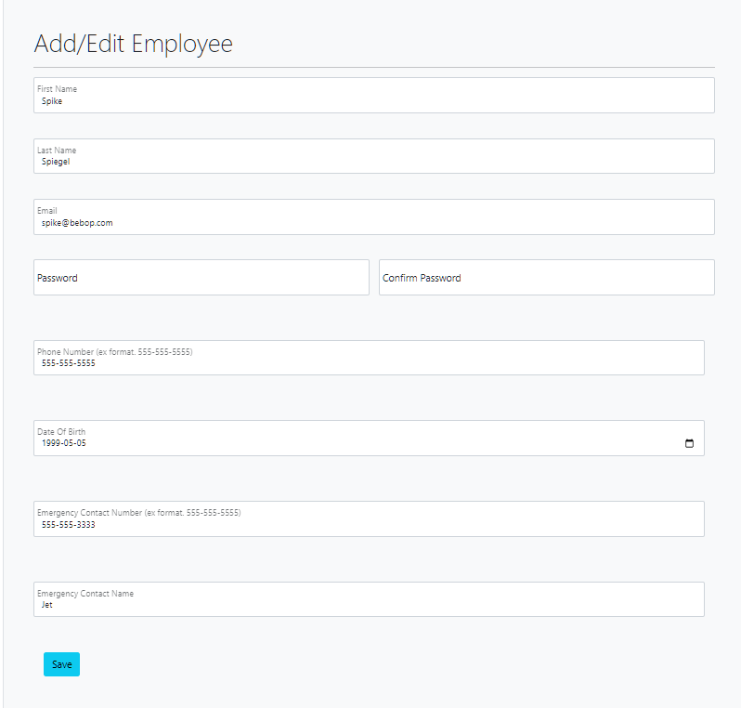
Employee Dashboard-Update profile
Employee can update the personal information in their profile
(Certain form fields are omitted.)

Slide 11
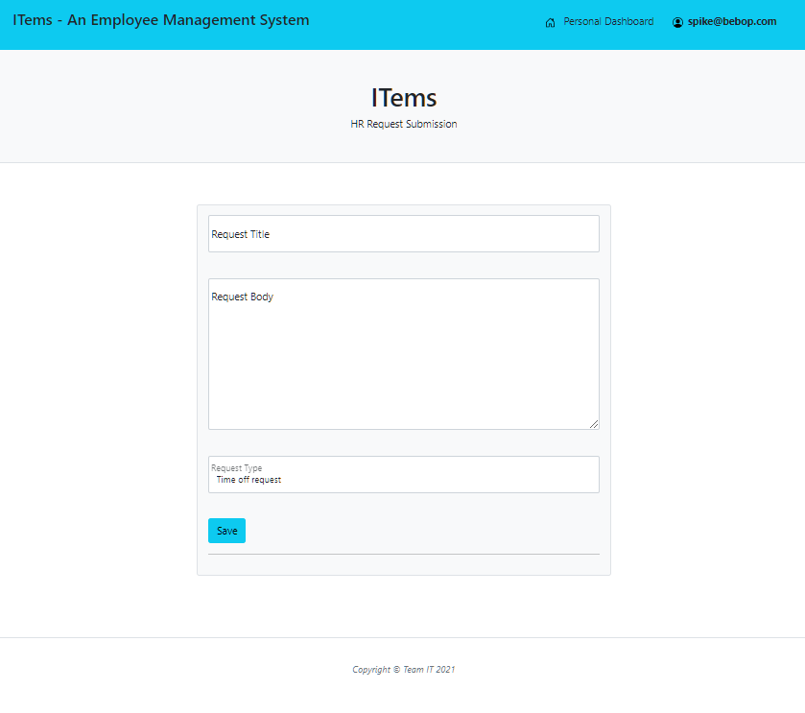
Employee Dashboard-Submit HR request
Employee can submit a request with title and details. They may request a transfer or time off

Slide 12
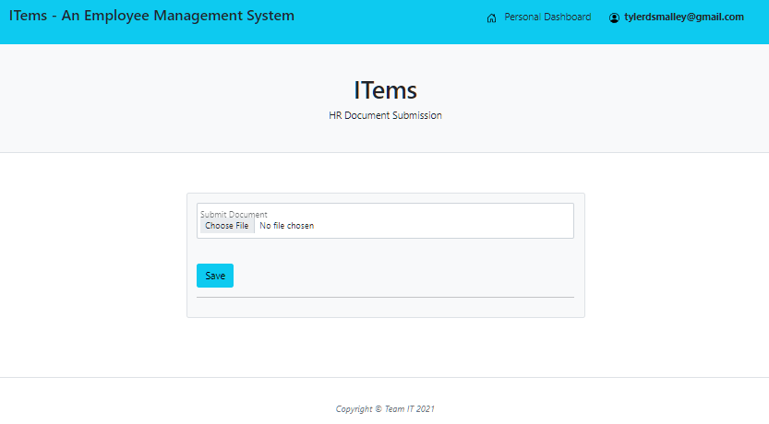
Employee Dashboard-Upload document
Employee can upload a document and it will be attached to their profile

Slide 13
Challenges,
Solutions,
&
What we learned

Slide 14
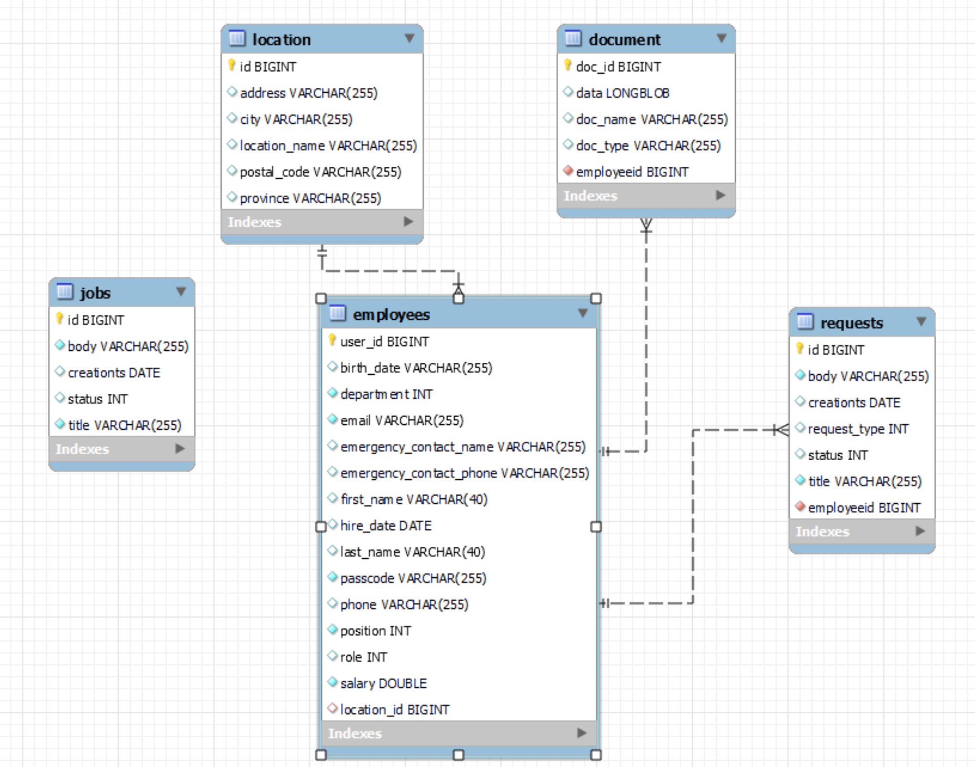
Database Structure

Slide 15
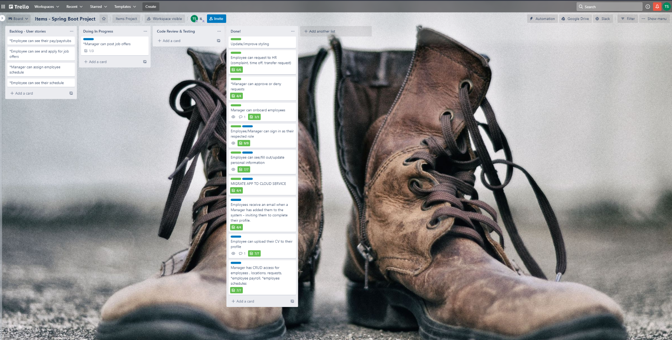
Project tasks - a true integration

Slide 16
Thymeleaf
And the many pitfalls of a form

Slide 17
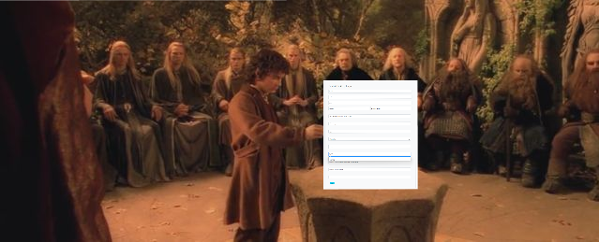
Registration/Update
One form to rule them all….
…..And in the background…bind them.
Update employee as admin
Update personal profile
Maintain different endpoints depending on ROLE
Restrict access to certain fields to non MANAGER

Slide 18
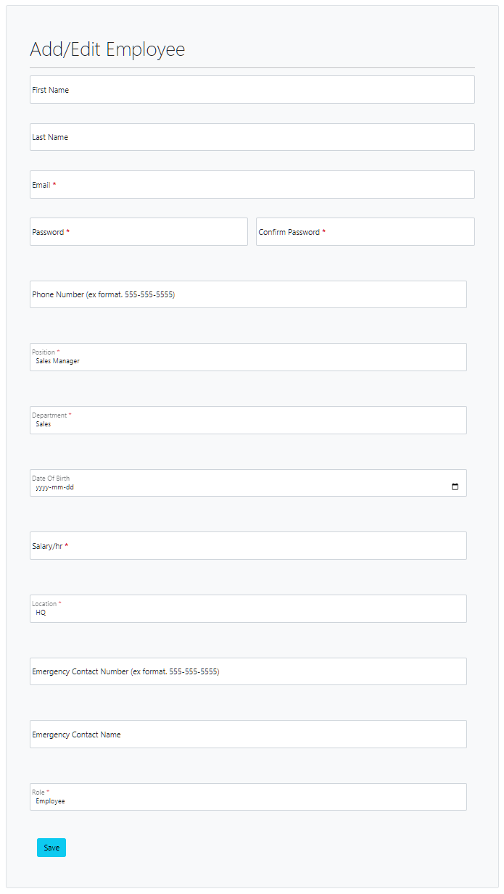
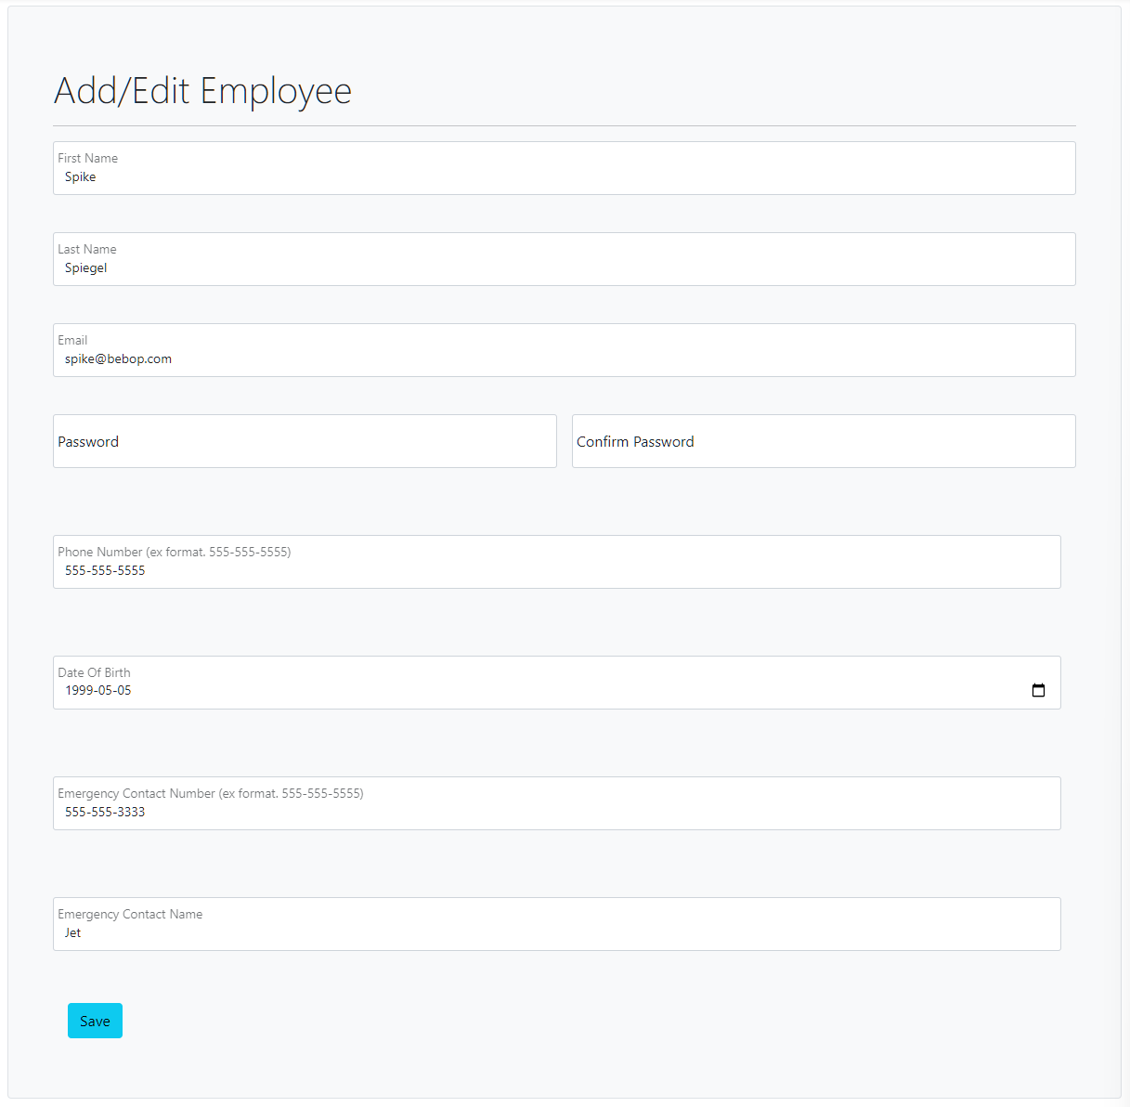
One form-Two Users
An employee should not be able to change:
Position
Department
Salary
Location
ROLE
How to hide fields when you’re using the same template for both scenarios?

Slide 19
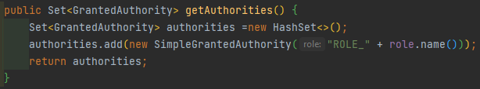
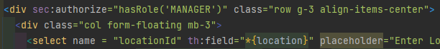
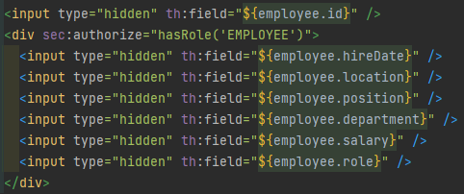
Form Solution
Grant user authority according to ROLE assigned in employee record
Wrap the form inputs that you want restricted in a div that checks for ROLE authority
On the employee update form, make sure you include hidden inputs for those fields that were omitted so you don’t update the employee records with null values.

Slide 20

Handling Registration/Update
With one form that has the same action/post request, how to we make sure the user ends up in the right place at the end?
Additionally, how do we make fields, such as password entry, optional?

Slide 21
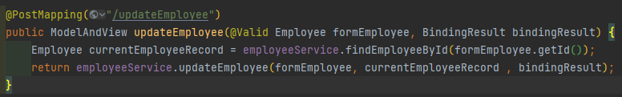
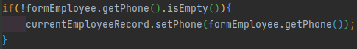
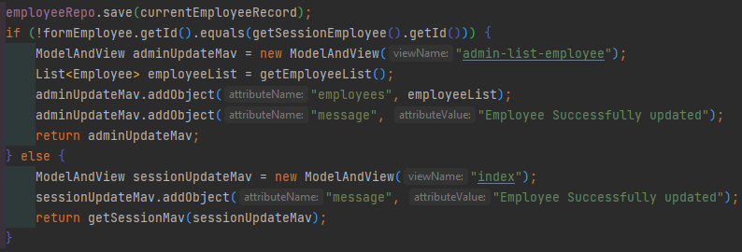
Handling Solution
One PostMapping for the form sends the form data, pulls the current employee record and sends both to the update method
Check the form data for data input before setting. This allows blank fields
Send user on their proper destination:

Slide 22

Error handling
Just when you thought you were finished….
How do you display errors when your form needs data to populate it’s fields?

Slide 23
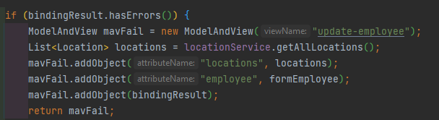
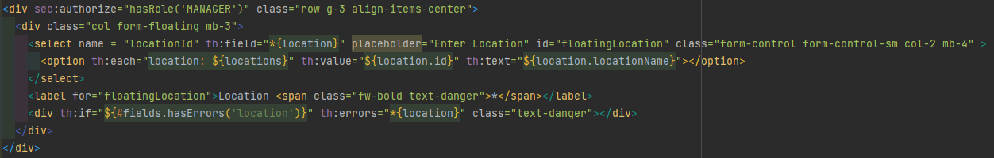
Error handling Solution
Instead of returning a string/url to the handler, build a new ModelAndView so you can add the location object list to the form

Slide 24
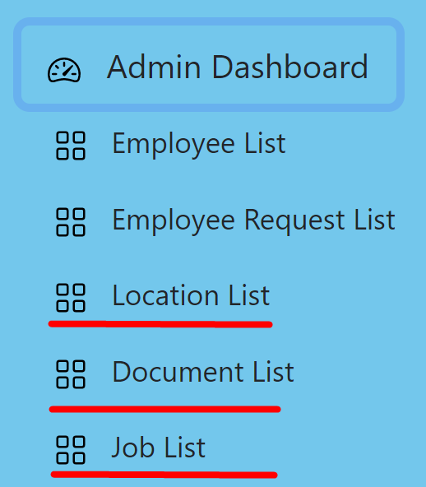
Admin for Locations/Jobs/Documents
Overview of Functionality
Allows site administrator to control company locations
Allows control of job postings
Allows view and/or edit of database tables
Allow admin to view uploaded Documents

Slide 25
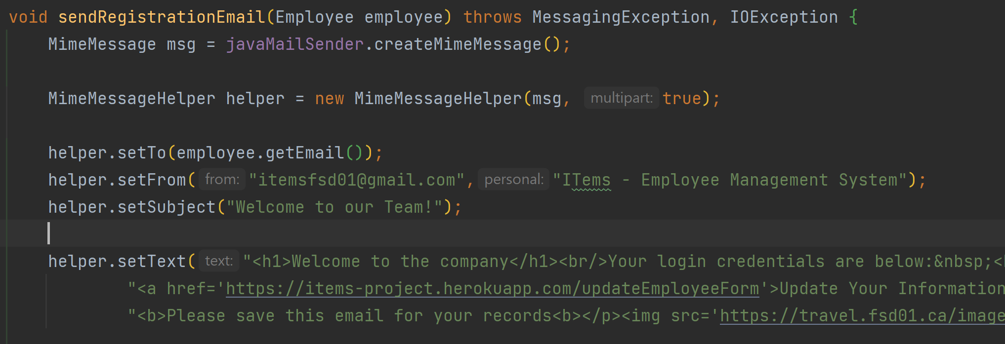
New Implementations - Challenge
Challenge: Send out emails with HTML instead of plain
text
Challenge: Deploying on Heroku
Solution: Create Mime Message and set MimeMessageHelper to true to allow HTML. Setup Gmail account to allow less secure apps
Solution: Lots of troubleshooting! Heroku doesn’t appear to like dependencies for both MySQL and PostgreSQL in Pom.xml

Slide 26
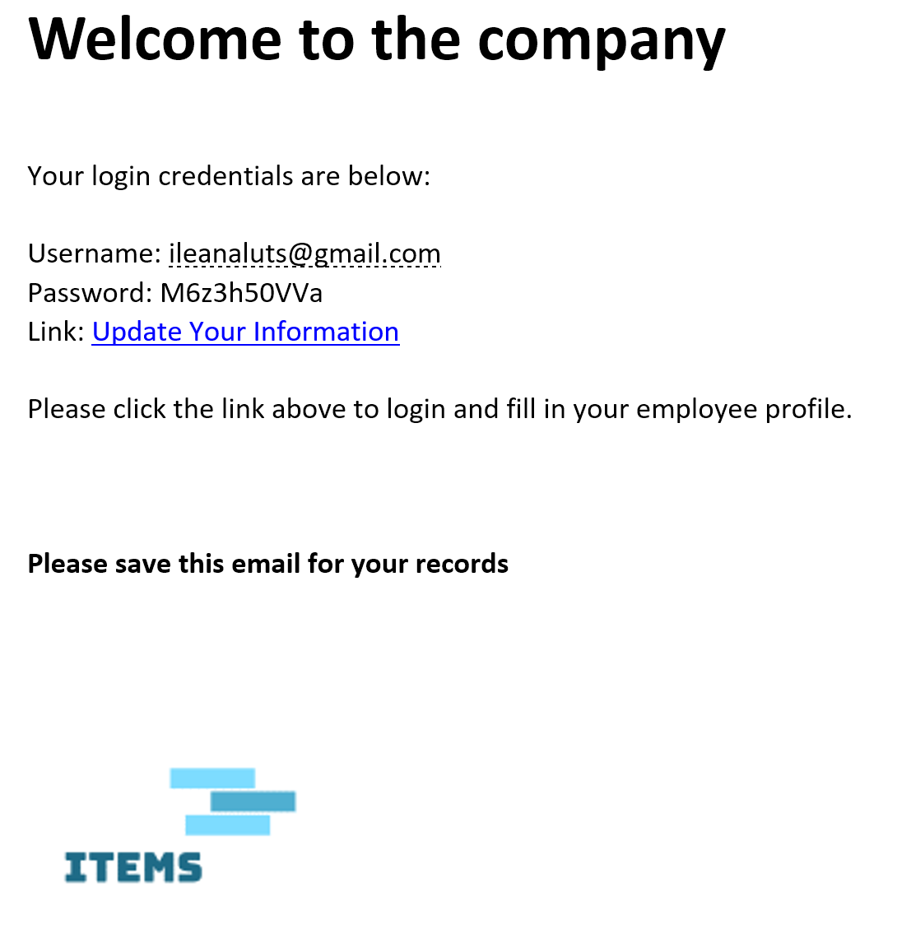
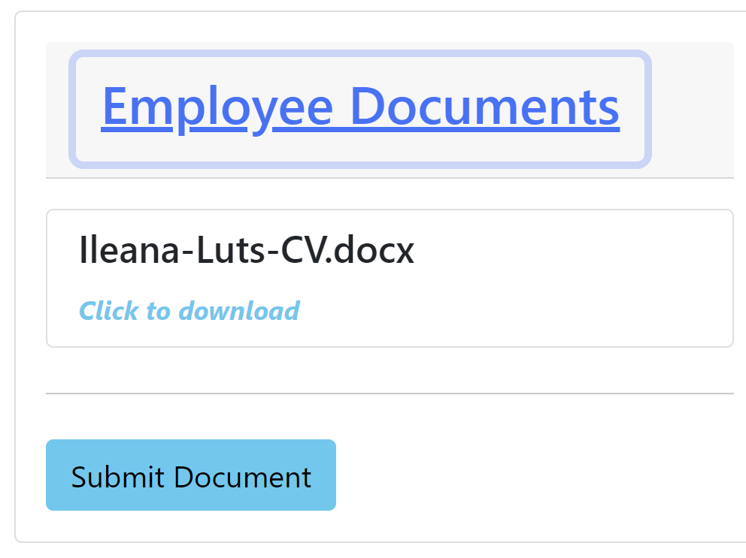
New Implementations
Allow users to upload files and save them in database
Ability to download those files
Sending out email with JavaMail

Slide 27
Summary
A Manager can onboard a new employee
The new hire receives an email inviting to complete company registration
A manager has full CRUD functionality for employee lists, location lists, HR requests, and job postings
An Employee has a dashboard where they can:
update their profile
send an HR request, check request status
Upload documents

Slide 28
Future Work
Big things to add
Job Postings (partially completed)
Payroll Tab
Scheduling
Little things to add
Better Styling (perhaps a different template engine)
Implement template engine for HTML emails
Misc optimizations

Slide 29
Thanks!
Team IT
Ileana and Tyler

